Slide 1
Session 1
Using practical tools to support professionals where there are concerns of child sexual abuse
Hampshire, Isle of Wight, Portsmouth and Southampton(HIPS) Safeguarding Children Partnerships

Slide 2
Self-care
Sitting through upsetting training sessions can be challenging, but there are strategies to help you cope:
Prepare mentally: Remind yourself why you’re taking part in this session and the importance of the topic.
Focus on the purpose: helping prevent child sexual abuse.
Take breaks: If you need to, step out briefly during training.
Self-compassion: Be kind to yourself and understand that it’s normal to feel upset when learning about such sensitive topics.
Seek support: Talk to your fellow participants, a trusted friend or colleague about your feelings and experiences during the training.
Grounding techniques: Practice deep breathing or focussing on your surroundings to calm your nerves and ground yourself during emotionally charged content.
There are organisations to speak to someone such as the

Slide 3
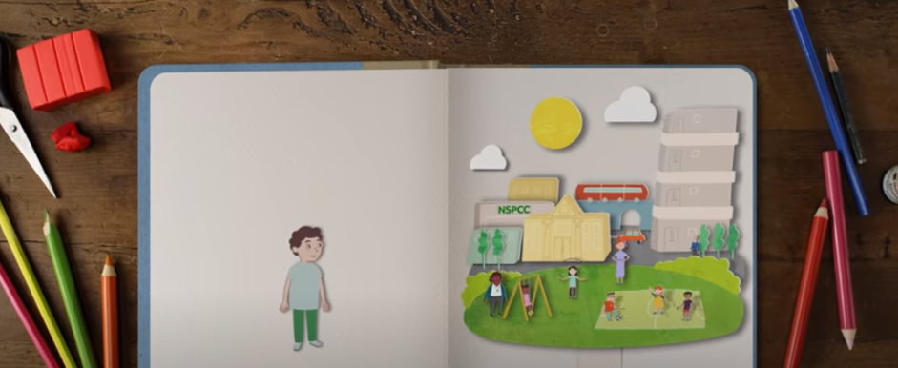
Session 1
Preventing Child Sexual Abuse

Slide 4
Session 1
Introductory Group Exercise
a) What does the term ‘child sexual abuse’ include?
b) As a group / or with partners, generate a list of the different types of child sexual abuse i.e., within the family environment.
c) Generate a list of examples of Child Sexual Abuse

Slide 5
What is child sexual abuse?
The definition of Child Sexual Abuse is set out by the UK Government in its statutory guidance, Working Together to Safeguard Children
Child sexual abuse “Involves forcing or enticing a child or young person to take part in sexual activities, not necessarily involving a high level of violence, whether or not the child is aware of what is happening. The activities may involve physical contact, including assault by penetration (for example, rape or oral sex) or non-penetrative acts such as masturbation, kissing, rubbing and touching outside of clothing. They may also include non-contact activities, such as involving children in looking at, or in the production of, sexual images, watching sexual activities, encouraging children to behave in sexually inappropriate ways, or grooming a child in preparation for abuse. Sexual abuse can take place online, and technology can be used to facilitate offline abuse. Sexual abuse is not solely perpetrated by adult males. Women can also commit acts of sexual abuse, as can other children.”
Hampshire, Isle of Wight, Portsmouth and Southampton (HIPS) Safeguarding Partnerships toolkit: What is Child Sexual Abuse

Slide 6
Typology of Child Sexual Abuse
The Centre of Expertise on Child Sexual Abuse has defined nine different typologies of child sexual abuse offending:
within the family environment
through trusted relationships outside the family environment
through an intermediary
through online interaction
through viewing, sharing or possessing images
through groups and networks
an arranged and perpetrated for payment
through a personal connection
through attack by an unknown person
Please visit the HIPS Child Sexual Abuse toolkit for further details on these typologies

Slide 7
Signs and Indicators
Although children find it very difficult to tell us about the harm they are experiencing, they may show other emotional, behavioural and physical signs of their abuse.
It is vital that professionals have the knowledge, skills and confidence to recognise when children might be showing them that something is wrong, as well as the potential indicators of sexually abusive behaviour in those who may be abusing them.
TASK: As a group, generate a list of signs / indicators of Child Sexual Abuse from the child

Slide 8
Signs and Indicators: A template for identifying and responding to concerns of child sexual abuse
There are some factors within the family or environment which can increase opportunities for abuse to occur, understanding what these are will enable us to reduce risks and build strengths when we are concerned.
TASK: As a group, generate a list of signs / indicators of Child Sexual Abuse factors within the family and environment
The Centre of Expertise on Child Sexual Abuse has a Signs and Indicators Template to help professionals to gather the wider signs and indicators of sexual abuse and build a picture of their concerns. Watch short video

Slide 9
Signs and Indicator: A template for identifying and responding to concerns of child sexual abuse
1 in 3 children sexually abused by an adult told anyone
5 in 6 children sexually abused by another child adult told anyone
It simply isn’t likely that a child will feel able to tell professionals directly what is happening or sometimes recognise that what is happening to them is abuse.

Slide 10
Case Study Exercise
Which indicators can you identify?

Slide 11
Reflection
How might we use the signs and indicators template in our setting?
How might this template be used to promote a multi-agency response to Child Sexual Abuse?

Slide 12
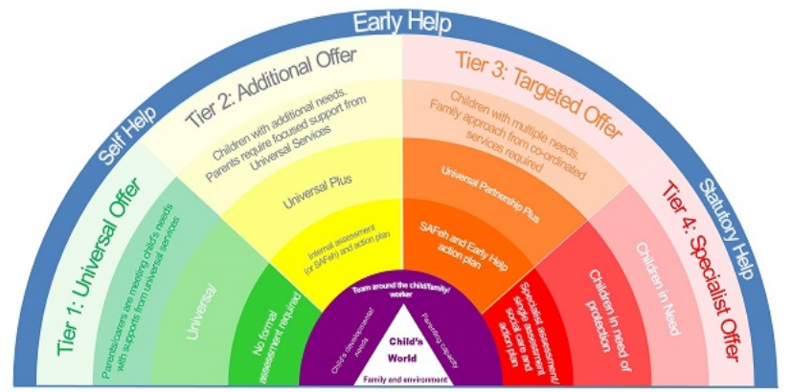
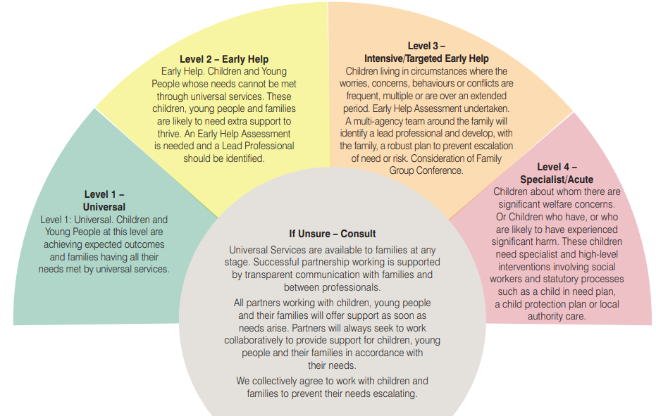
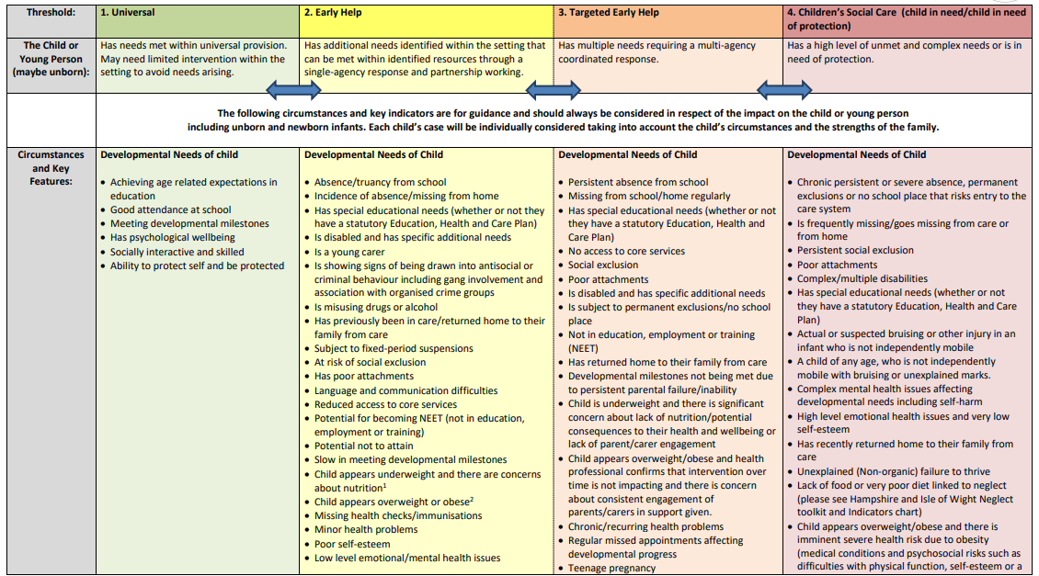
Referrals
Your local safeguarding children partnership has a guidance document or threshold chart to support professionals in completing a referral.
TASK: Consider the case study – how might this document support a professional when they are making a MASH referral for this case?
Hampshire and Isle of Wight Threshold Chart
Portsmouth Threshold Document
Southampton Pathways Document

Slide 13
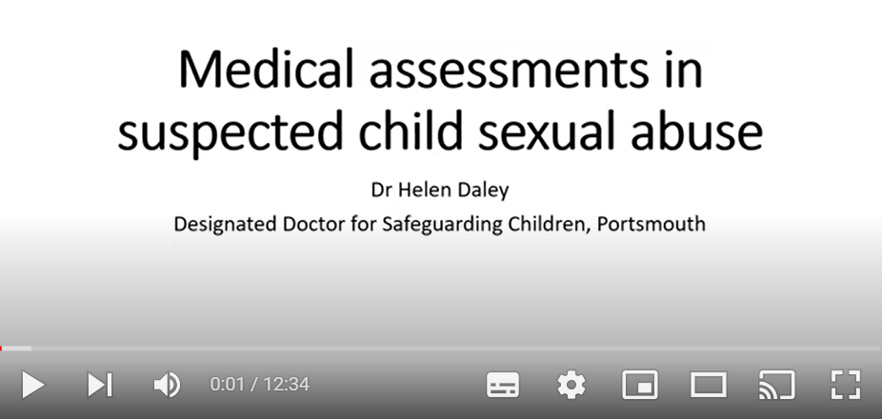
Medical Assessments in Suspected Child Sexual Abuse
Supporting professionals in understand the role and importance of Medical Assessments in Suspected Child Sexual Abuse.

Slide 14
Prevention and Resources
What can we do in our setting to keep children safe from child sexual abuse?
How can our agency / setting support multi-agency work to keep children safe from child sexual abuse?
HIPS Child Sexual Abuse toolkit

Slide 15
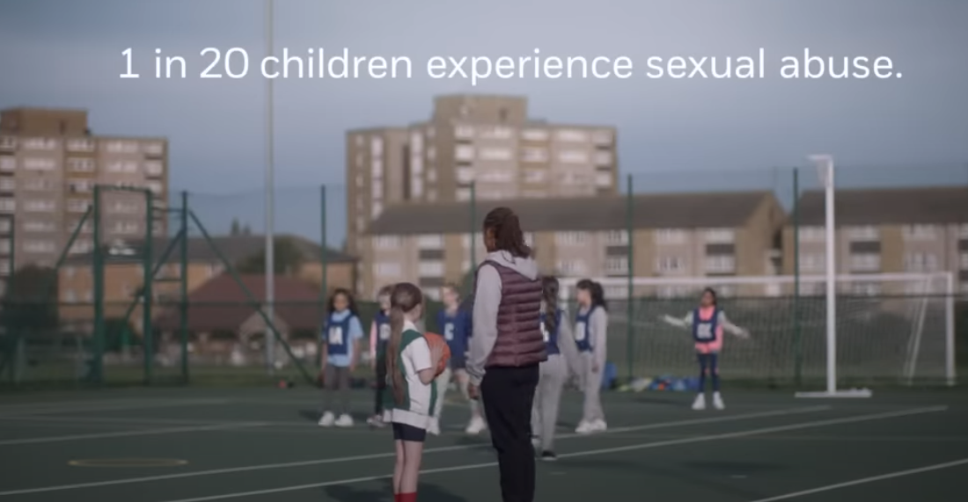
Prevention and Resources
NSPCC “Say Something” video

Slide 16
Self-care
Sitting through upsetting training sessions can be challenging, but there are strategies to help you cope:
Prepare mentally: Remind yourself why you’re taking part in this session and the importance of the topic.
Focus on the purpose: helping prevent child sexual abuse.
Take breaks: If you need to, step out briefly during training.
Self-compassion: Be kind to yourself and understand that it’s normal to feel upset when learning about such sensitive topics.
Seek support: Talk to your fellow participants, a trusted friend or colleague about your feelings and experiences during the training.
Grounding techniques: Practice deep breathing or focussing on your surroundings to calm your nerves and ground yourself during emotionally charged content.
There are organisations to speak to someone such as the

