Slide 1
Every Sleep Counts

Slide 2
Aims of the training session
The training will help professionals to:
Understand the importance of safe sleep and what it is.
Understand why environments may not be a safe place for a baby to sleep.
Explain the criminal charge of overlaying.
Understand the risk factors associated with Sudden Infant Death Syndrome.
Understand the importance of a multi-agency approach.
Support the workforce to deliver the safe sleep message to parents and carers

Slide 3
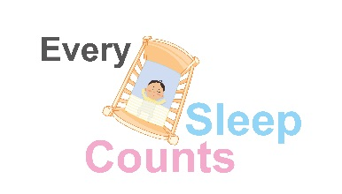
Social media
#everysleepcounts

Slide 4
Why are we doing this programme
Since April 2016 13 babies have died in Hampshire where unsafe safe sleep was a presenting factor.
A survey of professionals highlighted the need for consistent messages to be shared with parents/ carers by multiple agencies at stages throughout pregnancy and post birth.
The need for clarity relating to the criminal offence of overlaying.
To bring messages regarding safe sleep together in one accessible leaflet.
#everysleepcounts
Notes:
Talk about Hampshire cases
Variety of circumstances; duvet on a floor, alone on sofa, co-sleeping on sofa- with/ without drugs/ alcohol, co-sleeping in a bed with/ without medication/ drugs/ alcohol, sleep aids, other areas makeshift beds.

Slide 5
What do we want to achieve
Reduction in the number of baby deaths where unsafe safe sleep is a presenting factor.
Support for professionals to give the safe sleep messages.
A consistent message is given to parents/ carers.
Parents/ carers are aware of all sleep risk factors.
#everysleepcounts

Slide 6
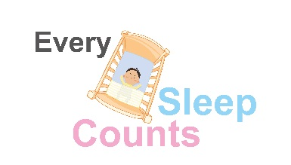
SIDS Background
https://www.youtube.com/watch?v=HOik35TCvEk
Please be aware that the contents of this film may be emotionally distressing

Slide 7
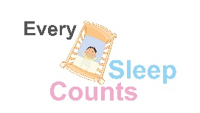
Co-sleeping and sudden infant death syndrome
The cause of sudden infant death syndrome (SIDS) is not fully known.
It is possible that many factors contribute but some factors are known to make SIDS more likely.
These can include:
The association between co-sleeping and SIDS whether the co-sleeping was intentional or unintentional and place of sleep (sofa v bed)
The association of smoking (mother and partner/carer) and SIDS
The association of co-sleeping and SIDS and parent/carer alcohol and drug use
The association between SIDS and low birth weight or premature babies.
Across the UK, on any one night, 22% of babies will be in bed with their parents.

Slide 8
Baby Development
Young babies will wake frequently during the night and need to be fed and cared for – this is normal and not modifiable
Many mothers sit up in bed when feeding their baby to try to stop falling asleep, if she unintentionally falls asleep this can make the sleep position dangerous for the baby
Babies thrive on comfort and parents can feel that co-sleeping is the only way to settle the baby
Young babies are unable to re-position themselves
Babies have an immature nervous system and are unable to regulate their body temperature
The baby’s head is the site of 40% of heat production and up to 85% heat loss – therefore covering the head (with hats/blankets) could result in thermal imbalance, which is associated with SIDs.

Slide 9
Babies sleep needs
Newborn sleep needs
Most newborn babies are asleep more than they are awake. Their total daily sleep varies, but can be from 8 hours up to 16 or 18 hours. Babies will wake during the night because they need to be fed. Being too hot or too cold can also disturb their sleep.
Sleep requirements at 3 to 6 months old
As your baby grows, they'll need fewer night feeds and will be able to sleep for longer. Some babies will sleep for 8 hours or longer at night, but not all. By 4 months, they may be spending around twice as long sleeping at night as they do during the day.
Baby sleep at 6 to 12 months
For babies aged 6 months to a year, night feeds may no longer be necessary and some babies will sleep for up to 12 hours at night. Teething discomfort or hunger may wake some babies during the night.

Slide 10
Types of sleep
REM sleep for babies is called 'Active Sleep’.
During gestation babies' sleep is mostly Active/REM sleep.
After birth Active/REM sleep remains dominant (>50%), and when babies fall asleep they fall first into Active/REM sleep (which means they can easily be awakened during this period).
After about 20 minutes they drop into Quiet Sleep (this is the 'floppy baby' stage of sleep when they can easily be moved without being disturbed).

Slide 11
What is Every Sleep Counts
Every Sleep Counts is a programme of prevention aimed at parents and carers.
It supports professionals to deliver consistent key safe sleep messages at numerous touch points during pregnancy and after birth.
It brings together information on multiple risk factors associated with unsafe safe sleep.
#everysleepcounts

Slide 12
The message
The safest place for your baby to sleep is on their back in a cot or moses basket in the same room as parents/ carers for the first six months.

Slide 13
The message
Car seats
Car seats should only be used for journey’s. If a baby is under six weeks old they should be taken out for a stretch every 30 minutes and every hour once they are over 6 weeks old.
Young babies don’t have full control of their heads which can drop forwards making it difficult for them to breath.
Babies can’t regulate their own temperature and can over heat in car seats if overdressed as cars can heat up very quickly.
#everysleepcounts

Slide 14
The message
Co-sleeping
Babies can not regulate their own temperature and can easily overheat.
Duvets and pillows might cover their face and make it difficult to breath.
An adult could roll onto the baby causing death or serious harm.
#everysleepcounts

Slide 15
The message
Smoking
Smoking significantly increases the risk of Sudden Infant Death Syndrome.
Parents should be encouraged to quit smoking during pregnancy and after birth using quit smoking services available in Hampshire.
Parents that continue to smoke should be made aware of the increased risk and encouraged to keep a smoke free environment around the child. This includes washing hands and changing clothes after smoking and before coming into contact with the baby.
#everysleepcounts

Slide 16
The message
Drugs and alcohol
Alcohol, street drugs and some prescription or over the counter medication can make you drowsy and may impact your response to a baby.
This can include some antihistamines, cold and flu medication and others, different people will react differently to medication.
#everysleepcounts

Slide 17
The message
Travel cot
A travel cot is an ideal place for a baby to sleep when away from home but do not add any extra padding because the mattresses are thinner babies need a firm flat sleep surface.
#everysleepcounts

Slide 18
The message
Makeshift bed
Airbeds, sofa cushions, folded duvets or blankets, footstalls and pouffes are not safe for a baby to sleep on as they can move and are soft.
They can also get too warm which could cause a baby to overheat.
#everysleepcounts

Slide 19
The message
Sleep aid
Sleep products are designed for specific ages and sizes, using a product that is not suitable for the babies age/size can be very dangerous.
Just because something is made by a brand you know or sold on the high street doesn’t make it safe.
In America a very well known brand of baby products has recalled their sleep aid due to an number of deaths over a ten year period.
#everysleepcounts

Slide 20
The message
Sofa
A sofa is one of the most dangerous places to fall asleep with a baby and increases the risks of Sudden Infant Death Syndrome by up to 50 times.
Babies could fall off the sofa or get wedged down the back making it difficult for them to breathe.
#everysleepcounts

Slide 21
Planning ahead
It is important to plan ahead for every nap/ sleep time, whether its for a day out, a trip to the shops a night away or a holiday. Every sleep counts.

Slide 22
What can parents do to reduce the risk of SIDS
DO
always place your baby on their back to sleep
place your baby in the "feet to foot" position – with their feet touching the end of the cot, Moses basket, or pram
keep your baby's head uncovered – their blanket should be tucked in no higher than their shoulders
let your baby sleep in a cot or Moses basket in the same room as you for the first 6 months
use a mattress that's firm, flat, waterproof and in good condition
breastfeed your baby, if you can

Slide 23
What can parents do to reduce the risk of SIDS
DON’T
smoke during pregnancy or let anyone smoke in the same room as your baby – both before and after birth
sleep on a bed, sofa or armchair with your baby
share a bed with your baby if you or your partner smoke or take drugs, or if you've been drinking alcohol
let your baby get too hot or too cold – a room temperature of 16C to 20C, with light bedding or a lightweight baby sleeping bag, will provide a comfortable sleeping environment for your baby

Slide 24
Who is currently involved in the programme?
Midwifery
Health visiting
GP’S
Family Support Services
Police
Early Years
Housing
Police
Notes:
This will be expanded to include other agencies

Slide 25
Safe Sleep Programme
Adult mattresses are not made to be safe for babies
Pictures in the media don’t support safe sleep messages
When babies first start to move it is important that if the roll onto their sides/ fronts that they are placed back onto their backs once it is noticed as they may not be able to roll themselves back
#everysleepcounts

Slide 26
The HIPS partnership has agreed to ensure that all safe sleep messages are delivered to parents consistently across the areas.
This will include adopting learning and responding to recommendations from both local and national child safeguarding practice reviews and/or thematic reviews around child deaths linked to safe sleeping arrangements.
Any immediate safeguarding concerns should be addressed in a timely manner following local safeguarding children partnership (LSCP) procedures.
HIPS Safe Sleep Procedure

Slide 27
It is the practitioner’s responsibility to discuss and record the information they give to parents/carers about safe sleeping arrangements at all key contacts.
Information must be provided in a manner that is understood by the parent/carer. For parents/carers who do not understand English, an approved interpreter should be used.
Similarly, families with other communication needs should be offered information in such a way as best facilitates their understanding.
HIPS Safe Sleep Procedure

Slide 28
Choosing to co-sleep with a baby is a very personal choice and some parents will choose to do so. This means that their baby shares the same bed with an adult for most of the night and not just to be comforted or fed.
It is vital that professionals support parents to make informed choices and to ensure that these choices are made with full awareness and understanding of the potential risks, as well as ways to mitigate/reduce these risks.
HIPS Safe Sleep Procedure

Slide 29
If, following receipt of safe sleep messages and advice the level of risk is sufficient to cause professional concern, or should a parent/carer choose not to follow safer sleep messages and advice, all professionals must document their concerns and what they've done to mitigate them.
Professionals could consider, with consent, contacting the family’s health visitor to ask for their advice.
Professionals should consider any barriers that may be impacting on parenting capacity (including learning difficulties, substance misuse, mental health issues, poverty) and if safeguarding concerns persist, professionals should refer to the neglect guidance.
HIPS Safe Sleep Procedure

Slide 30
Overlay Offence
Where the cause of death for an infant under 3 years is suffocation (not caused by disease/ foreign body etc.) The infant was in bed with a person who has attained the age of 16 years. & that person was under the influence of drink or a prohibited drug either when they went to bed or at any later time before the suffocation. N.B. includes any kind of furniture or surface used for the purpose of sleeping
Notes:
Some of you may have heard of this offence however many have not
We unfortunately respond to a number of incidents a year where a child has died and there is a potential link to co sleeping.
The key to this offence is whether we as the police suspect that the person who has co slept has taken any alcohol or a prohibited drug (one not prescribed to them legally).
Often police are called in the middle of the night or early morning and even if not under the influence then the offence may still be relevant if they drank before going to bed.
There is no specific level (e.g. drink drive)
This includes sofa’s or other furniture.

Slide 31
Police Response
If there is suspicion then -sensitive however we must secure evidence:
Arrest & seizure
Request evidential toxicology samples
Interview
Present cases to CPS
Even where there is no suspicion..
Request a voluntary sample at hospital
Part of the coroners process allowing the influence of alcohol or drugs to be excluded.
Notes:
In order to fulfil our role police must respond quickly and effectively to secure evidence of a potential offence- this therefore requires

Slide 32
Wider Neglect Considerations (wilful)
Those who allow others to sleep with their child when they know they are under the influence of drink/ drugs?
Co-sleepers on prescription drugs which increase the risk- clearly warned about the dangers of co sleeping?
Those who are not providing a safe sleep environment despite repeated clear warning?- sofa/ lilo?
Notes:
Just because the Overlay offence is not applicable does not prevent police considering a wider neglect offence.

Slide 33
Key points
Prevention is the key- we all must play a role
Clear messaging to parents about risk and the offence (and why it exists)
Clear recording of direction parents/ carers to show wilfulness
We do not want to criminalise parents/ carers but all children have a right to life and we have a duty therefore to investigate offences where apparent.

Slide 34
How can professionals help parents?
Help parents understand the importance of a safe sleep environment for every sleep.
Highlight potential increased risks.
Discus alternative options where risk factors are identified.
Enable parents to make informed decision regarding where their baby sleeps.
Inform parents/carers about sharing the Every Sleep Counts leaflet with anyone who cares for your baby.

Slide 35
Introducing Every Sleep Counts to parents/ carers
Parents and carers will be given the Every Sleep Counts leaflet as part of their booking pack at approximately 12 weeks gestation. This is to enable them to make informed decisions when purchasing equipment for their baby.
Conversations will take place with parents/ carers throughout pregnancy by midwives and following birth by health visitors.
Safe sleep is also included in the GPs six week check.
Multi agency partners will give messages based on prevention or intervention depending on the circumstances of their contact. This may include parenting groups, induction packs or home visits.

Slide 36
Materials
Every Sleep Counts toolkit
Notes:
The Every Sleep Counts group have developed a number of different tools to support practitioners in delivering the key messages to parents. All of these can be accessed via the online toolkit.
Highlight the leaflet, poster and glow in the dark stickers (images on next slides)
A train the trainer package has been developed and sessions will be held over the coming months
Case scenarios and an in-depth case study have also been developed for discussion within your team meetings.

Slide 37
Materials
Notes:
The information on the leaflet includes a number of different places a baby may be put to sleep highlighting the associated risks and reminding parents of the safest place for their baby to be put to sleep. It also highlights the need for advice to be followed for every sleep.

Slide 38
Materials
Notes:
The poster is printed on the back of the leaflet and can be used as an easy read version for those who have learning difficulties or whose first language isn’t English.

Slide 39
Materials
Notes:
Glow in the dark stickers to be placed on or near the cot as a reminder to parents.

Slide 40
Pilot Findings
Really good but need crosses by the pictures in the leaflet, not just crosses on the poster (Dad - Marketing Manager)
No because I know this already, but I think this is a good idea to keep it close that information is where you need it
Yes its made me more aware about the risks
Yes ! I would feel confident chatting to parents about safe sleeping
I didn't know the suffocation law but it is a good law
Do you plan to follow the advice in this leaflet?
100% yes (Dad)
Yes, however, pictures can be misleading - needs to be obvious at a glance what pictures are demonstrating unsafe practice
I will follow the advice in this leaflet
Clear and detailed information on leaflet. Picture of baby asleep in a cot looks like she is being strapped down - doesn't look like a blanket. Not obvious what
It’s a good tool to use with parents to help lead a conversation and ensure you cover all points
Yes, it is helpful but I do not like how it is set out. The main picture looks like the baby is strapped down rather than being under a thin blanket
Notes:
Some comments left by responders

Slide 41
Materials
Notes:
We will be tweeting safe sleep messages please like and re-tweet using the #everysleepcounts

Slide 42
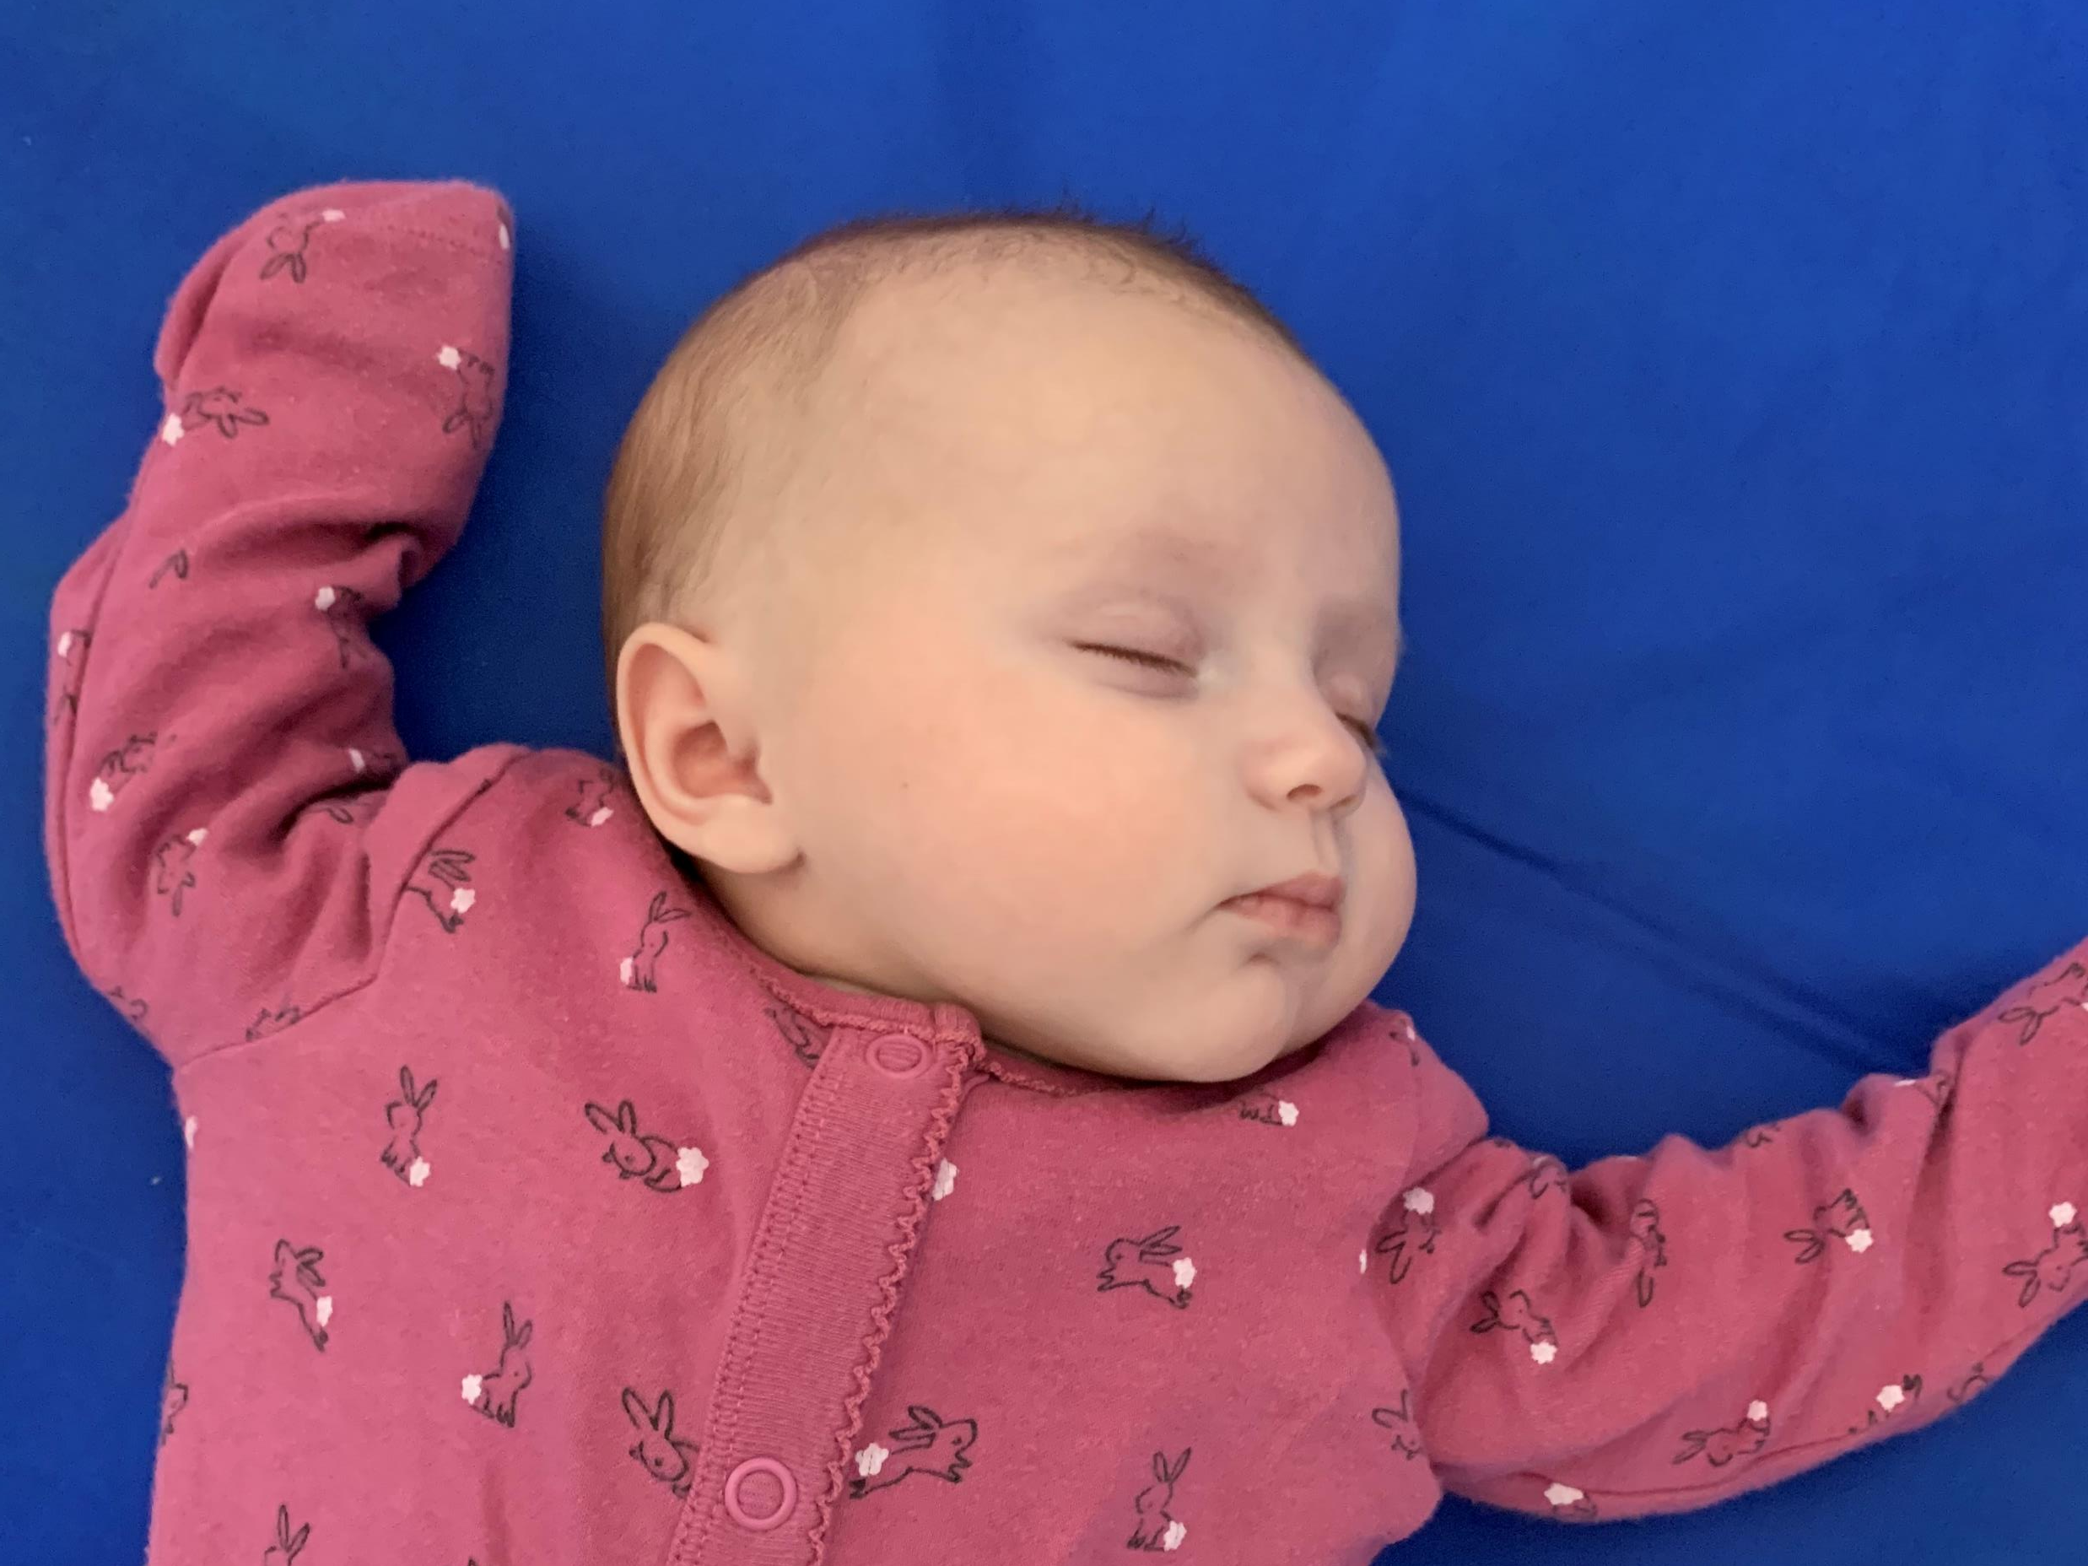
Notes:
Pic of Ella- this is why we are doing this programme
In what circumstances may you as settings and childminders identify unsafe seep situations or be able to have conversations about safe sleep?

