Slide 1

Moira Smyth
Participation Officer

Slide 2

Nearly half (45 per cent) of LGBT pupils - including 64 per cent of trans pupils - are bullied for being LGBT in Britain's schools.
Half of LGBT pupils hear homophobic slurs 'frequently' or 'often' at school.
Seven in 10 LGBT pupils report that their school says that homophobic and biphobic bullying is wrong, up from half in 2012 and a quarter in 2007
However, just two in five LGBT pupils report that their schools say that transphobic bullying is wrong
Just one in five LGBT pupils have been taught about safe sex in relation to same-sex relationships
More than four in five trans young people have self-harmed, as have three in five lesbian, gay and bi young people who aren't trans
More than two in five trans young people have attempted to take their own life. as have one in five lesbian, gay and bi students who aren't trans
Notes:
This is down from 55 per cent of lesbian, gay and bi pupils who experienced bullying because of their sexual orientation in 2012 and 65 per cent in 2007

Slide 3
Strategies the document is aligned to
World
United Nations Convention on the Rights of the Child
UK
Children and Families Act
Hants
Rights Respecting Education
Equality Act 2010
(DfE) and Government Equalities Office Inspiring equality in education (2016)

Slide 4
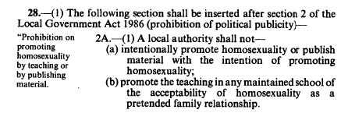
15 years
enacted on 24 May 1988
Repealed 18 November 2003

Slide 5

Launch of Guidance for Schools
Understanding statutory duties includes LGBT rights and Primary schools
Transgender a particular type of discrimination
Supporting individual pupils in a safe space
Celebrate Diversity
The school ethos and curriculum - with sample lesson plans
Supporting staff The charter of rights
Accreditation Local support for schools
Public Health
27th November 2018

