Slide 1
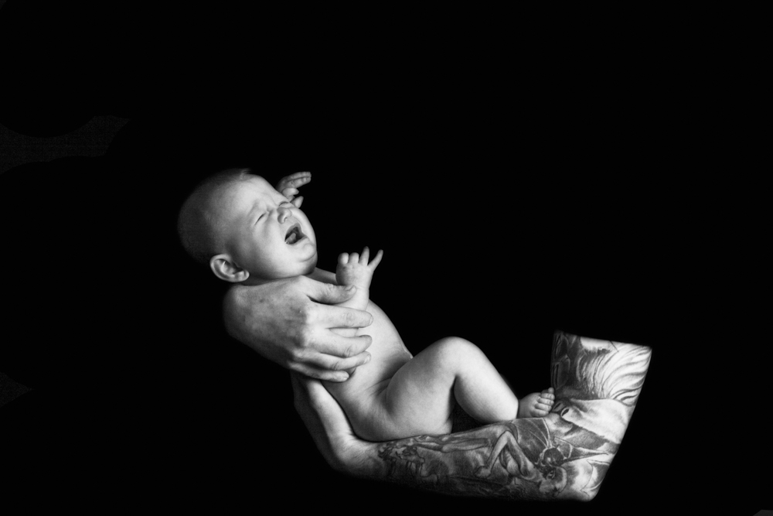


Training for trainers and professionals:
The ICON message

Slide 2
Aims of this training session
This training is designed to equip you with the knowledge, information and skills that you will need to discuss ICON: ‘Babies cry, you can cope’ with parents and carers
The training will help you to:
  share the message that crying in babies is normal
  support parents/carers to soothe their baby
  support parents to cope with a baby’s crying
  understand more about Abusive Head Trauma
  understand it is a form of child abuse

Slide 3
Background
AHT is abuse and is preventable
Crying is a known trigger
70% of babies who are shaken, are shaken by men
Our goal for ICON is to communicate to parents/carers that they can expect crying, prepare for it and cope with it
Our target is to reduce the incidence of AHT triggered by crying

Slide 4
Some “crying baby” facts
Parents may, at some point, struggle to cope with their baby’s crying
Evidence shows that in some extreme cases, crying can lead parents to feel like they may actually harm their child: This is an emotional response of both anger and frustration
It is important to offer an alternative response to help control these extreme emotions

Slide 5
Some more “crying baby” facts
Crying is a normal part of child development which can have a significant negative impact on the emotional health of parents
All babies will cry a lot from the ages of 2 weeks to 3-4 months, but this can vary from baby to baby
Crying seems to peak in the late afternoon and early evening… but this can vary

Slide 6
Some more “crying baby” facts
Crying is sometimes misdiagnosed as colic
No one is really sure why babies cry so much in this period… research is ongoing
An immature nervous system may make babies more irritable… Crying is their only means of expression!
ICON is an evidenced-based delivery method

Slide 7
Factors that can trigger AHT
In one survey, half of the mothers interviewed reported that their child’s crying made them feel like harming their child. Such feelings are rarely acted on, but it can be a trigger for a parent to actually harm and abuse their child.
Research shows that babies are most likely to be shaken when they are 2-3 months old… the time when babies cry the most.

Slide 8
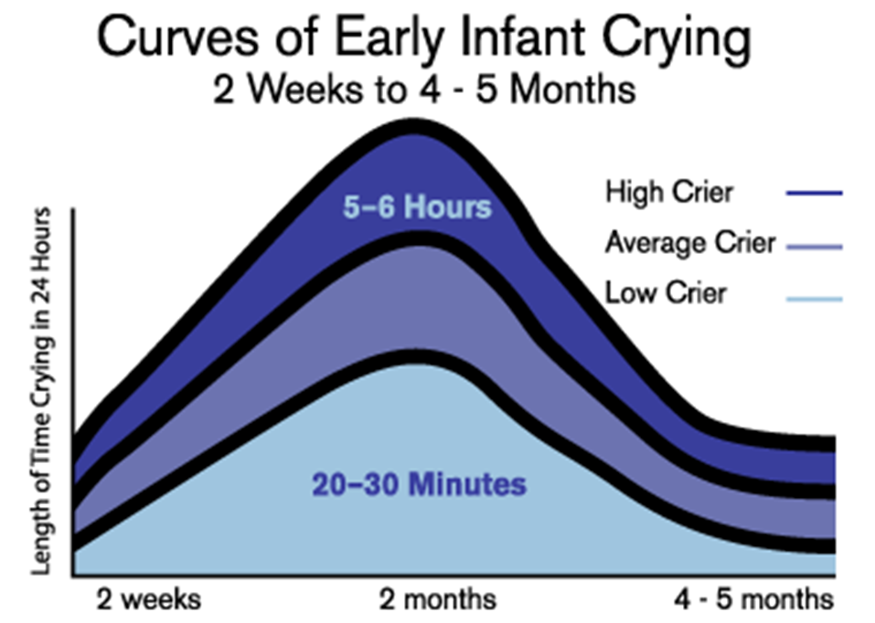
Normal Crying Curve

Slide 9
But… It’s not just the baby
Excessive infant crying can be associated with:
Parental stress
Depression
Possible relationship problems
Feelings of guilt, inadequacy and helplessness
Remember… this is a new experience for most parents

Slide 10
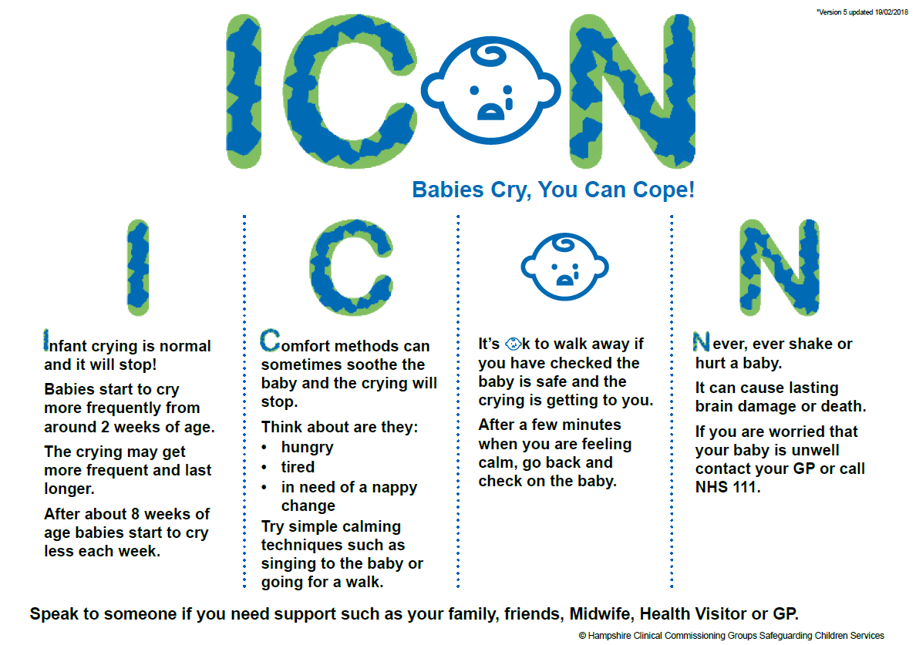
What is ICON?

Slide 11
More factors about Abusive Head Trauma
AHT is the most common cause of death or long term disability in babies
24 out of 100, 000 hospital admissions for babies are due to abusive head trauma
200 children are killed or hurt annually in the UK
These figures certainly underestimate the real numbers involved

Slide 12
Are some babies more at risk than others?
Research shows that the most at risk babies are:
Baby boys
Babies under 6 months old
Babies born pre-term or at low birth weight
Babies who have more contact with health services

Slide 13
Cost
Human and Emotional
Financial
  Hospitalisation
  Long term health and educational needs
  Medical equipment
  Legal proceedings
  Child Safeguarding Practice Review
Loss of societal productivity

Slide 14
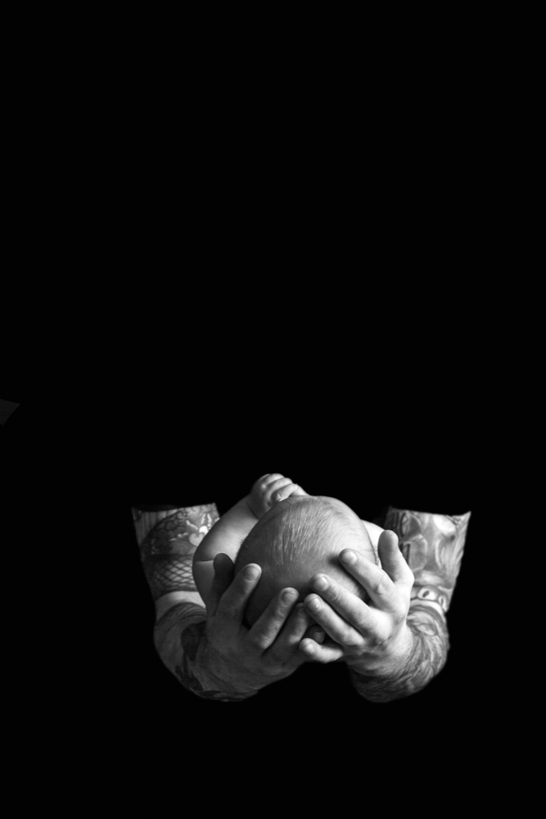
How can professionals help parents?
By offering ICON as an alternative to a situation where frustration (often linked to tiredness) can lead to abuse
By discussing the issues raised
By talking through the key points in the ICON leaflet

Slide 15
Introducing ICON to a parent/carers
Help parents understand that crying is normal… all parents can feel like this
Explain that crying is a normal part of development
Reassure parents that babies are not doing this on purpose
Support parents in coping with their own emotions and stress (Coping with Crying Plan)
Teach parents soothing and safe sleep techniques
Inform parents/carers about sharing the ICON leaflet with anyone who cares for your baby.

Slide 16
